Slide 1
HELP International Assignment
-VinayKumar V

Slide 2
ABSTRACT:
HELP International is an international humanitarian NGO that is committed to fighting poverty and providing the people of backward countries with basic amenities and relief during the time of disasters and natural calamities, In this case study is aimed at identifying the direst countries based on categorize of the countries using some socio-economic and health factors that determine the overall development of the country with the help of unsupervised machine learning technique using K-means and Principle Component Analysis

Slide 3
BUSINESS OBJECTIVE:
- Identifying the direst countries using some socio-economic and health factors using the unsupervised learning technique on the data set using various Machine learning models
To understand the driving factors (or driver variables) that help in forming clusters.
- To implement and utilise this knowledge in helping NGO decide to use the money strategically and effectively.

Slide 4
Problem Solving Method:
Step 1: Importing Data Set and Understanding data as per the Business point of view
Step 2: Data Cleaning, missing value treatment and outliers treatment
Step 3: Exploratory Data Analysis (EDA)
Step 4: Applying Principle Component Analysis (PCA) for dimension reduction and also avoid multicolinearity
Step 5: Applying K-Means Clustering to make countries as a clusters based on socio-economic and health factors ,etc(features)
To make funding decisions.

Slide 5
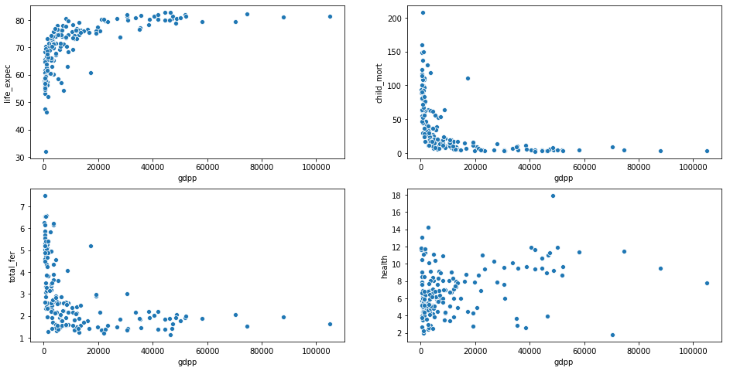
GDP VS Health Factor’s:

Slide 6
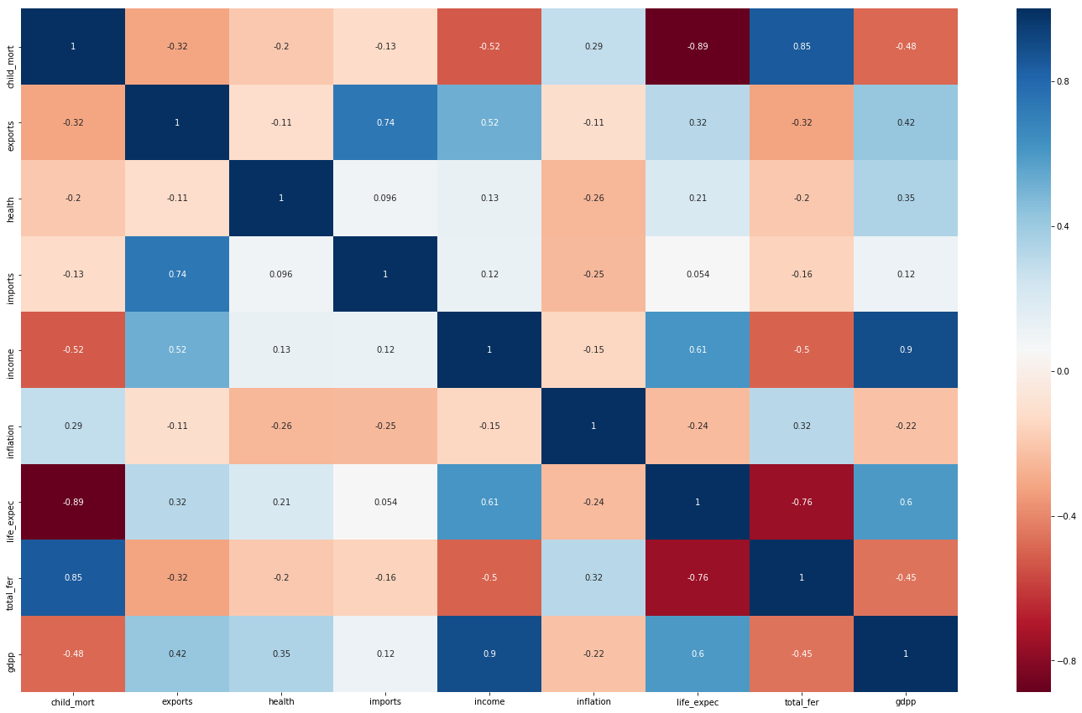
Correlations between the features:
Visualization on how various factors like Countries’ health, wealth and socio-economic factors depend on each other.

Slide 7
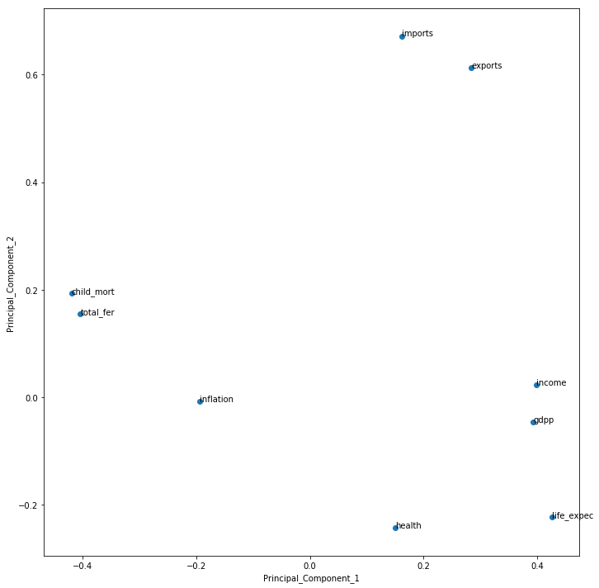
PCA:
# by the observation principal component 1 had more weight on life expec and health
# principle component 2 has more weight on imports and exports

Slide 8
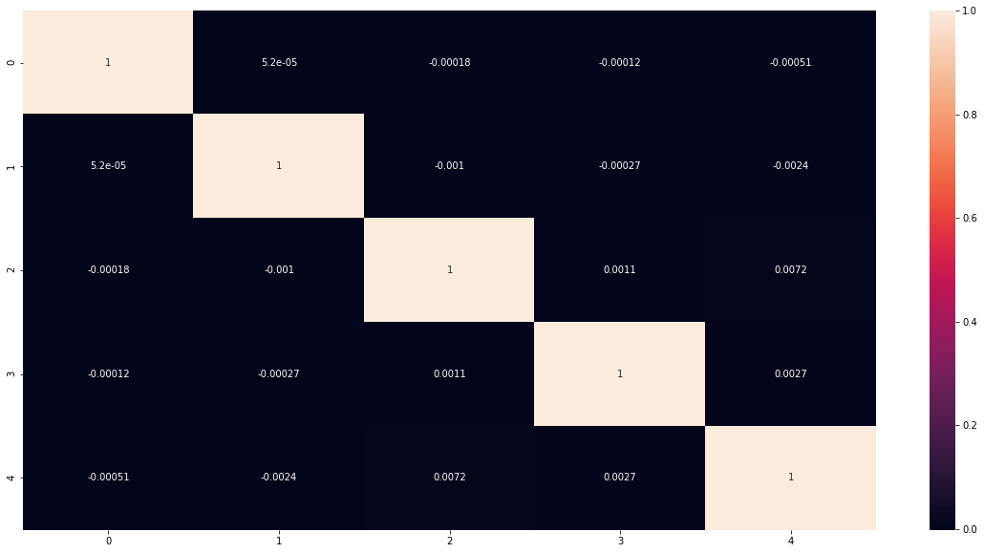
PCA Correlation’s:

Slide 9
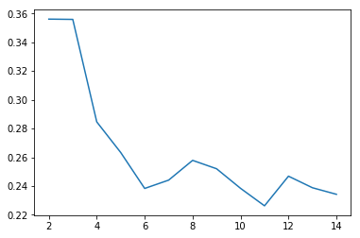
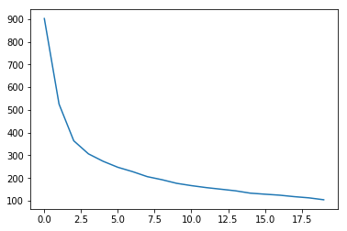
Choosing Number of Cluster’s :
To choose number of clusters (k) for the given data we used silhouette analysis
elbow curve saying to pick k=3 for clustering

Slide 10
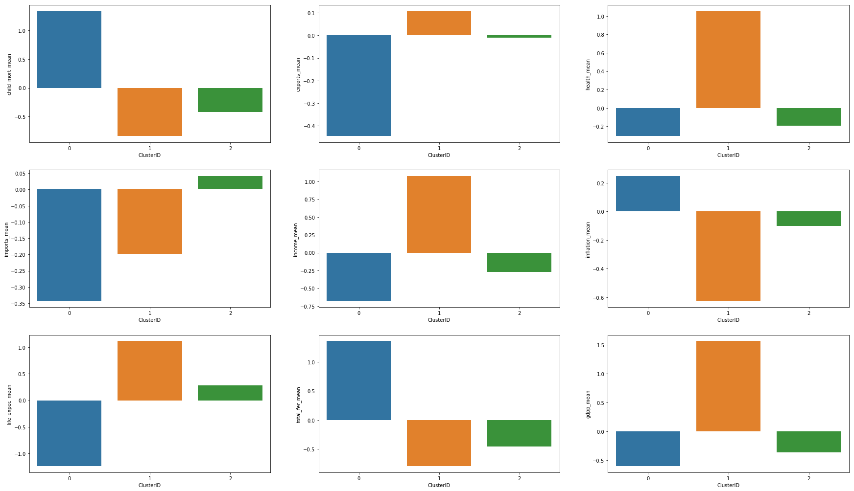
Cluster’s of features:
After observing Bar plots of principle components and original features the following observations/conclusions obtained.
principle component- 1 mean is very low for cluster_id-1 which means that Cluster-1 has low- income,low-gdpp,
high-child_mort and high-fert_rate.
principle component - 3's mean is little high for cluster_id-1 compared to cluster-2 which means that cluster-1 ia having high-inflation & low-health
So cluster_id-1 here needs more aid from the foundation

Slide 11
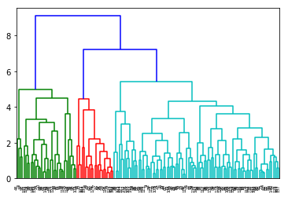
Hierarchical Clustering with PCA:

Slide 12
Summary:
The data is clustered to 4 data points.
NGO’s decision can be driven basing on Life Expectancy, Child Mortality, GDP and imports\Exports from the clusterId ‘0’ and ‘1’

Slide 13
Thank You!!

